Slide 1
Session 14
Data Sharing Techniques in ASP.NET MVC
For Aptech Centre Use Only

Slide 2
Session Overview
Describe ViewData
Define ViewBag
Explain the role of TempData
Describe strongly typed views
List the differences between various data sharing techniques
For Aptech Centre Use Only

Slide 3
Introduction to Data Sharing
ViewData
ViewBag
For Aptech Centre Use Only
TempData
Strongly typed view

Slide 4
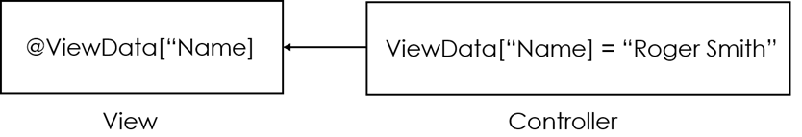
ViewData
For Aptech Centre Use Only
ViewData
ViewData is called as a KeyValue pair object or a Dictionary object. Through the use of ViewData, developers can transfer data from a controller to a view. By default, the type of ViewData is an object of ViewDataDictionary class. In this Dictionary object, Strings are used as keys to store and access value or data from ViewData.

Slide 5
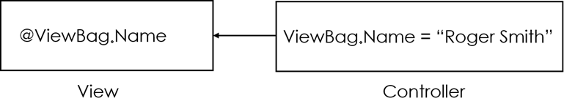
ViewBag (1-2)
ViewBag is used to transfer data from the controller to the view.
ViewBag is a dynamic data type property of the base class of all the controllers, which is the
For Aptech Centre Use Only
ViewBag
ControllerBase class.
Data stored into ViewBag is stateless

Slide 6
ViewBag (2-2)
 | ViewBag can be used to transfer data which is not in the model
 | from the controller to view.
For Aptech Centre Use Only
ViewBag is a dynamic data type, which internally uses
ViewData to store values.
Use ViewBag to store multiple properties and values.

Slide 7
TempData (1-2)
TempData is used only for current and subsequent requests as it is a very short-lived instance.
Redirecting is the only case when users can rely on TempData.
When redirecting, current request is killed, and a new request is created on the server to serve the redirected view.
Sharing data between the controller actions are done through the ASP.NET MVC TempData dictionary.
TempData value lasts until it is read or until the session times out of the current user’s session.
For Aptech Centre Use Only

Slide 8
Strongly Typed View (1-3)
For Aptech Centre Use Only
Strongly typed view is the view that bonds any model with a view

Slide 9
Strongly Typed View (2-3)
Automatic Scaffolding
IntelliSense Support
Compile Time Type Checking
Visual Studio is used to show IntelliSense with the help of the model.
Problems with data type are detected by the
For Aptech Centre Use Only
Depending on the
selected template and
model, it creates a view with skeleton.
compiler and compiler
errors are thrown rather than runtime errors.

Slide 10
Strongly Typed View (3-3)
It retrieves values from ViewData.Model, rather than setting them in properties.
It supports IntelliSense and type safety.
It does not include any unnecessary casting between types in ViewData.
It implements compile-time checks.
For Aptech Centre Use Only

Slide 11
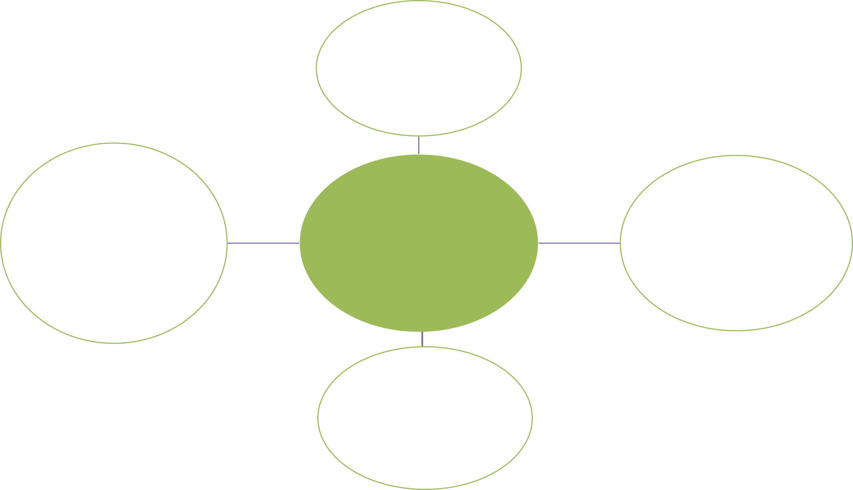
Data Sharing Techniques (1-2)
ViewData
For Aptech Centre Use Only
Strongly Typed View
Data Sharing Techniques
ViewBag
TempData

Slide 12
Data Sharing Techniques (2-2)
One controller to another controller
Controller to view
For Aptech Centre Use Only
Between subsequent HTTP
requests
One action to another action

Slide 13
Comparing Data Sharing Techniques (1-2)
To lookup data when it is included as
drop-down lists into an entity
When user profile widget or any widgets are included
When shopping cart components are included
For Aptech Centre Use Only
When aggregate data is included in small amounts

Slide 14
Comparing Data Sharing Techniques (2-2)
ViewData | ViewBag | TempData
It transfers data from the controller to the view. It can be accessed using strings as keys. | A dynamic wrapper around ViewData is View Bag. | If data is required for the next request also, then use TempData. Note that the data will be gone after the next request.
It obtains a null value in case of redirection. However, it also requires typecasting for complex data types. | It is found only in ASP.NET MVC 3 onwards. It can handle complex data types without typecasting. It obtains a null value in case of a redirection. | Data is passed from the current request to the subsequent request (redirection) using TempData. Due to this reason, TempData value will not be null.
Comparison Between ViewData, ViewBag, and TempData
For Aptech Centre Use Only

Slide 15
Summary
Methods used to transfer results from a controller to a view are as follows:
ViewData
ViewBag
TempData
Strongly typed view
ViewData is inherited from ViewDataDictionary class and is a dictionary of objects.
To transfer temporary data from the controller to the view, a ViewBag is used.
TempData is used to transfer data between the current and next HTTP requests.
Strongly typed view binds any model with a view. Various advantages are displayed by strongly typed view over standard view.
For Aptech Centre Use Only

